Slide 1
Implementation of security mechanisms using AES and RSA Hybrid Algorithm with Digital Signatures
Team Details
Shaista Firdous(20eg105442)
M. Sathvika(20eg105428)
K. Shiva Sai(19H61A05L6)
Project Supervisor
Dr. K. Madhuri
Associate Professor

Slide 2
Introduction
It is a secured hybrid algorithm used to protect the safe transmission of data in the Network communication using AES and RSA algorithm. To secure the text as well as key.
There are different parameters that are needed, those are AES Encryption/Decryption, RSA Encryption/Decryption, Hybrid Encryption, Secure Key Management, Random Number Generation, Secure E-mail transmission, Digital Signatures.
APPLICATIONS:
Secure Email Communication: Implementing AES for symmetric encryption and RSA for asymmetric encryption can ensure that emails are securely transmitted and only accessible to authorized recipients. This is crucial for protecting sensitive information in message exchanges, such as personal data, financial information, or confidential business communications.
Digital Signatures: RSA can be used for digital signatures, which verify the authenticity and integrity of email messages. A sender can sign their message with their private key, and the recipient can verify the signature.

Slide 3
Problem Statement
AES, a symmetric key encryption algorithm, offers efficiency but demands secure key sharing and management. It's not ideal for key exchange. RSA, an asymmetric algorithm, excels in key exchange but is relatively slow for encrypting large data. Key management is critical in hybrid encryption, ensuring secure key exchange between parties. RSA's slower speed may introduce computational overhead. Padding in RSA can increase data size.
The objective of implementing an AES and RSA hybrid algorithm is to develop a secure and efficient system that balances the strengths of these encryption methods. This project aims to enhance data security by leveraging AES for efficient encryption, RSA for secure key exchange, and protection of sensitive information. Key management is a critical focus, ensuring secure key distribution. The system will enable secure communication over untrusted channels, protect data integrity, and maintain practicality for real-world applications while being adaptable and scalable for various platforms and user needs. Rigorous testing and documentation will validate its security and functionality, ensuring a reliable solution for data confidentiality and integrity.

Slide 4
Proposed Method
1)Our proposed idea is we are using AES algorithm to encrypt the message using a key k, and we are using RSA algorithm to encrypt the key k using receiver’s public key PU, that cipher key is considered as “ck”.
2)The encrypted key and email are transferred to the receiver, then the receiver uses his private key to decrypt the “ck” then we get k, using k he will decrypt the cipher text.
3)Using above Hybrid algorithm we will ensure the confidentiality of the email, but in the next step we will check whether the sender is authorized or not.
4)For that we are using Digital Signature to authenticate the user, we are using RSA approach to encrypt the Digital Signature.
5)Using cryptographic hash function we generate a fixed-size hash value, which is a digital signature and using sender’s private key we encrypt that key and send that to the receiver.
6)Then, receiver will decrypt the digital signature using the sender’s public key, the using the same hash function the receiver will generate a hash value and compare it with the sender’s digital signature.

Slide 5
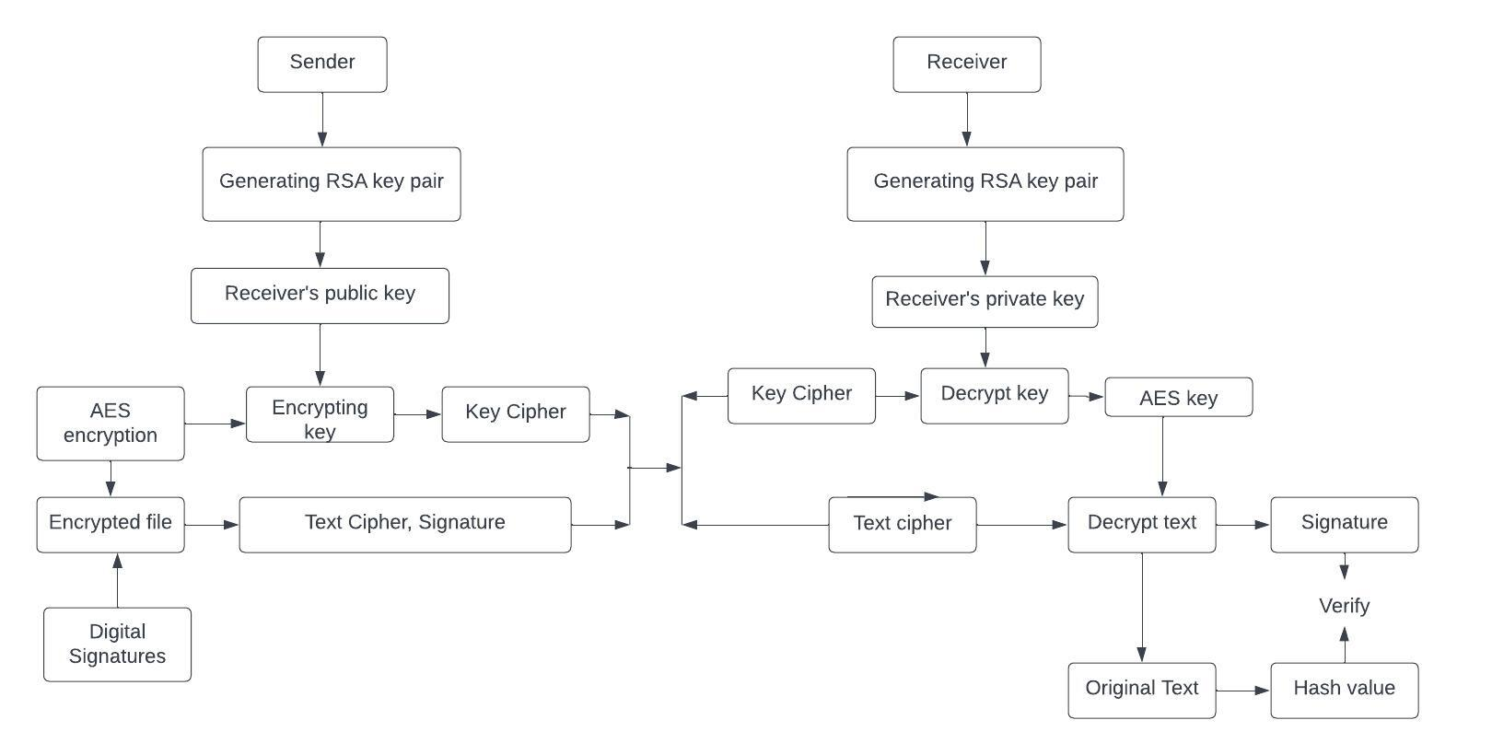
Proposed Method

Slide 6
Experiment Environment
To complete this project, for execution I have used python idle 3.11(64-bit)
Before using the python idle, I have installed packages in command prompt. Those are:
1)Pycryptodome
2)Cryptography
We have used different packages and libraries. Those are:
1) hashlib: In the code, hashlib is used to generate a SHA-256 hash value from the input message.
2) Crypto.PublicKey.RSA: The RSA module is used to perform RSA encryption and decryption.
3) Crypto.Cipher.AES: This module provides AES (Advanced Encryption Standard) encryption and
decryption functionalities.The AES module is used to encrypt and decrypt messages using AES in CBC mode.
4)Crypto.Random: The get_random_bytes function from this module is used to generate a random
initialization vector (IV) for AES encryption.
5)Crypto.Protocol.KDF.PBKDF2: This module provides the PBKDF2 key derivation function, which is used
to derive a key from the user's password.
6)base64: This module provides functions for encoding binary data to ASCII and decoding it back. In the code,
it is used to base64 encode the IV and ciphertext before sending it to the user.
7)math: The math module is used to perform mathematical operations. In the code, it is used to calculate
the greatest common divisor (gcd) of two numbers.
8)time: The time module is used to measure the execution time of certain parts of the code.

Slide 7
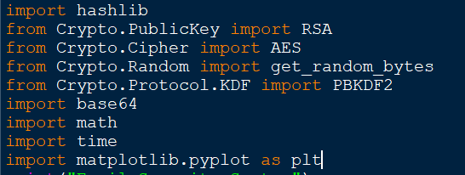
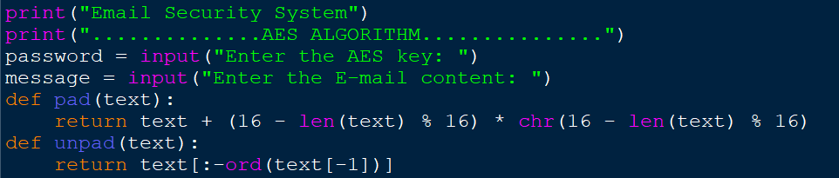
Experiment Screenshots
Libraries used in this project
Padding and unpadding the text

Slide 8
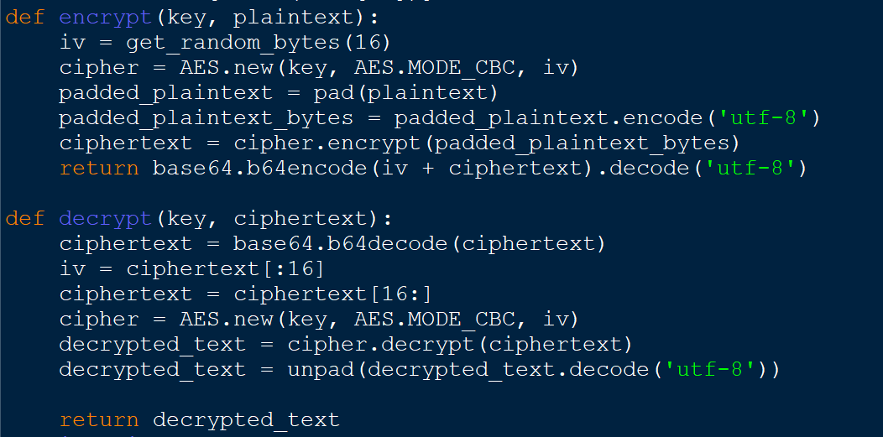
Experiment Screenshots
Encryption and Decryption of Email content: Here we are first padding random bytes to the text because in AES plaintext size is 16bytes, later we are encrypting. While decrypting we are removing the extra bytes we added and showing the plaintext we entered.

Slide 9
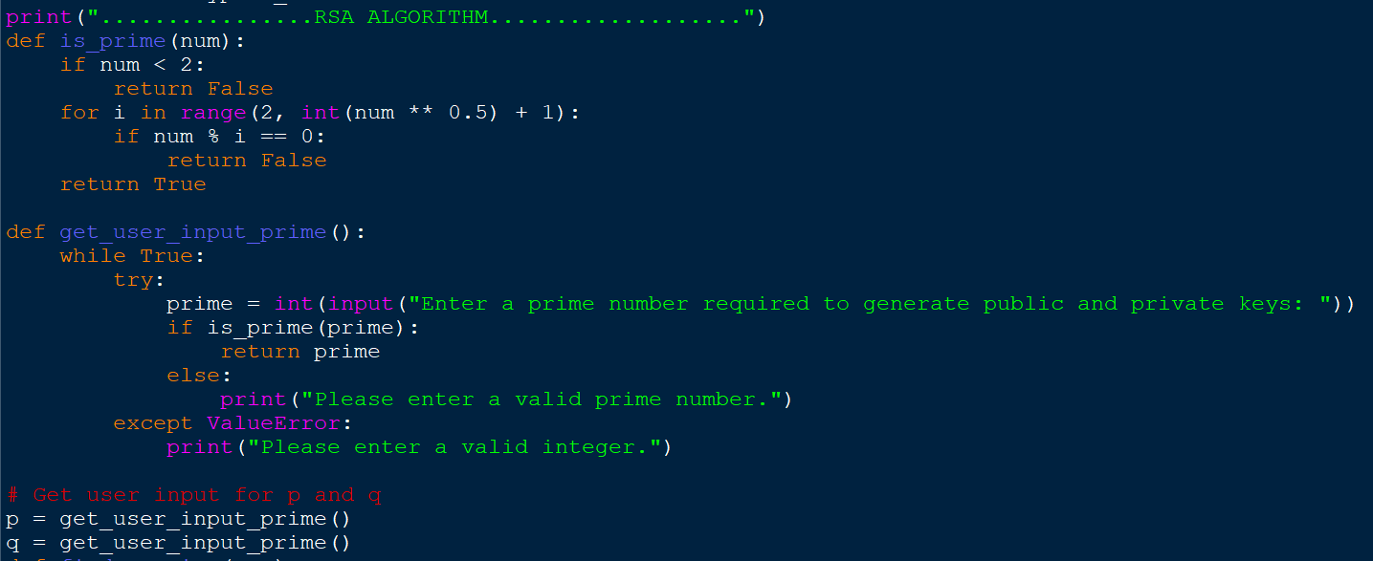
Experiment Screenshots
We are declaring values of p and q, which are prime numbers. Using this we are generating the public and private keys in RSA Algorithm.

Slide 10
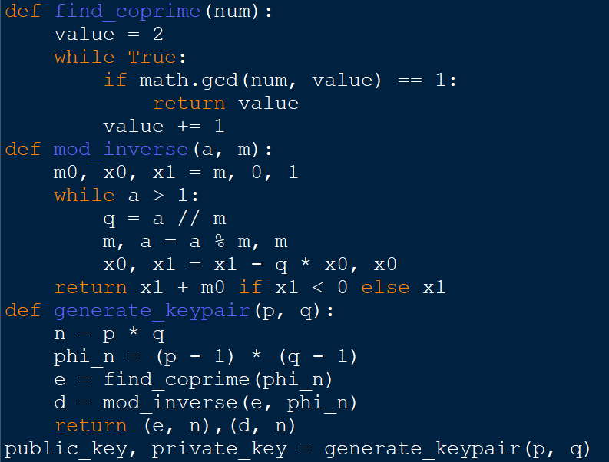
Experiment Screenshots
Using RSA mathematical calculations we are generating public and private keys.

Slide 11
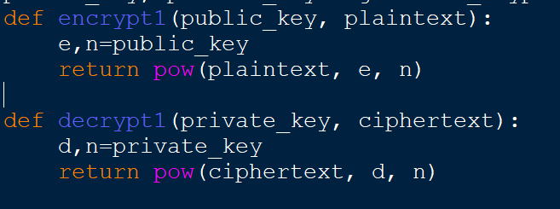
Experiment Screenshots
We are encrypting the AES key using RSA public key and decrypting it using RSA private key

Slide 12
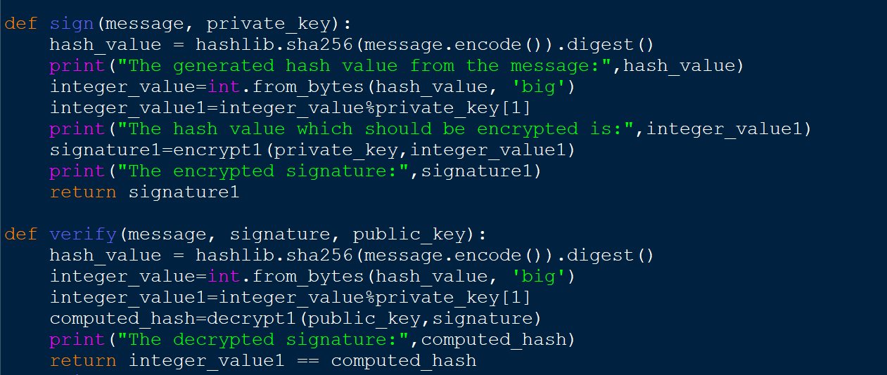
Experiment Screenshots
We are using RSA approach in digital signature to authenticate the user. We are generating hash value using SHA256 and considering it as digital signature.

Slide 13
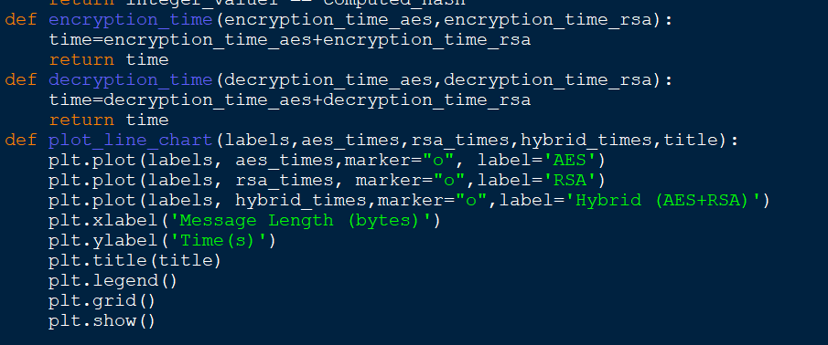
Experiment Screenshots

Slide 14
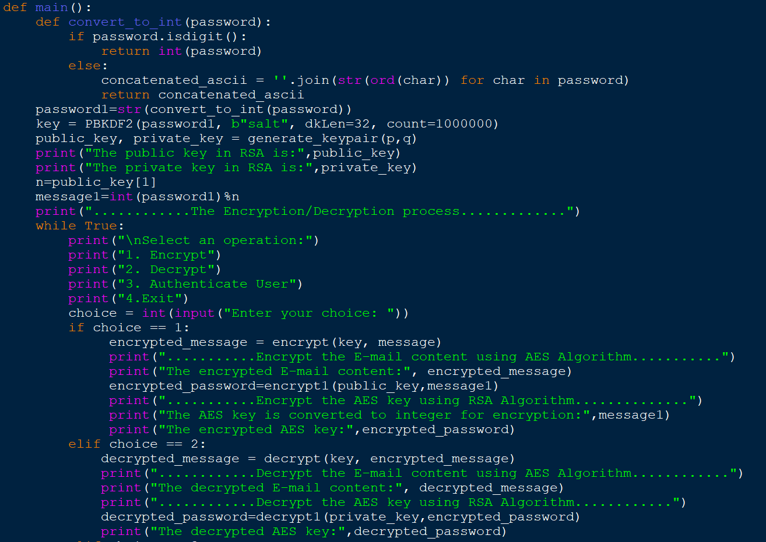
Experiment Screenshots

Slide 15
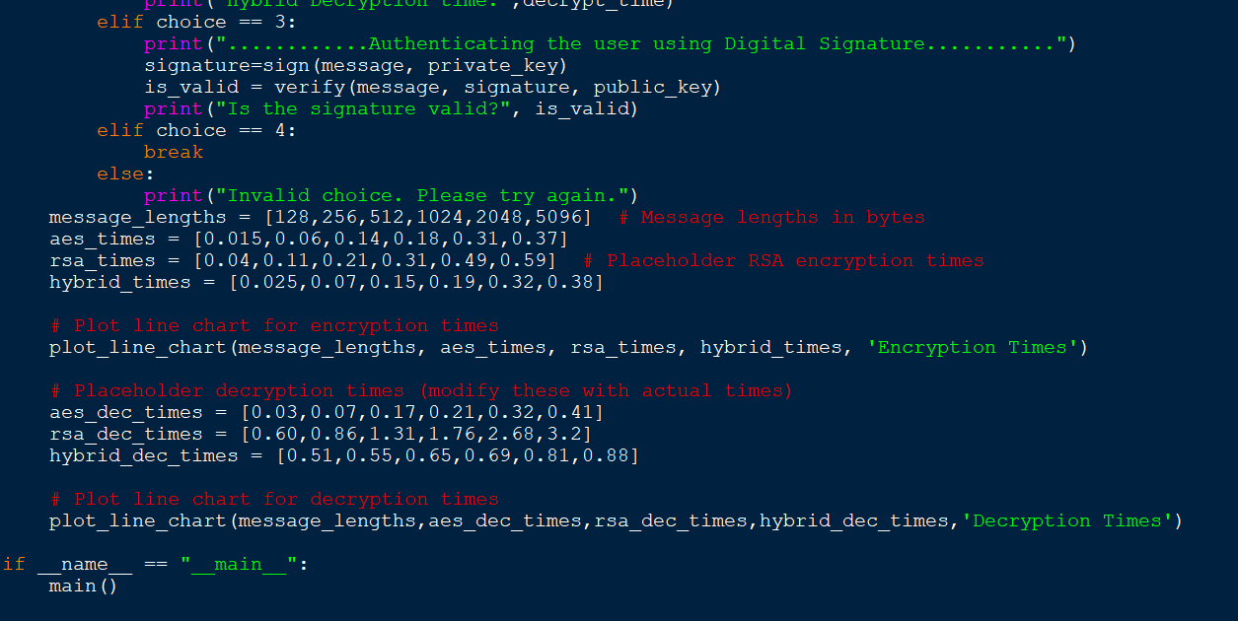
Experiment Screenshots

Slide 16
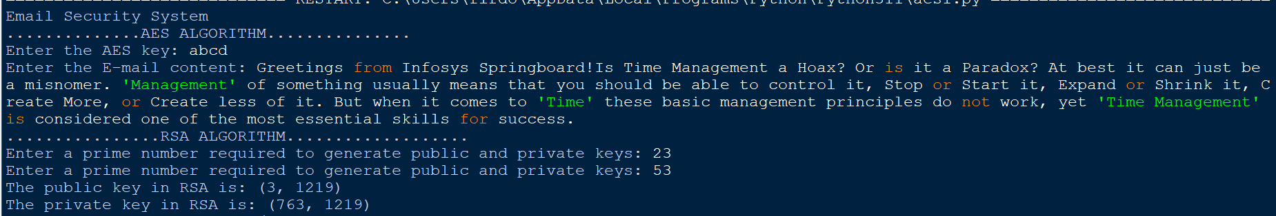
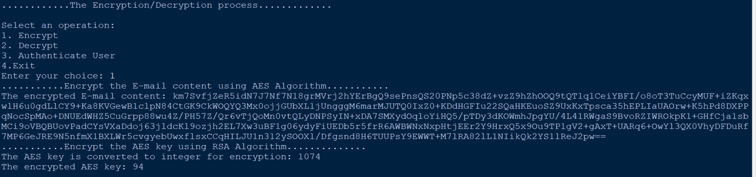
Experiment Screenshots
Output:

Slide 17
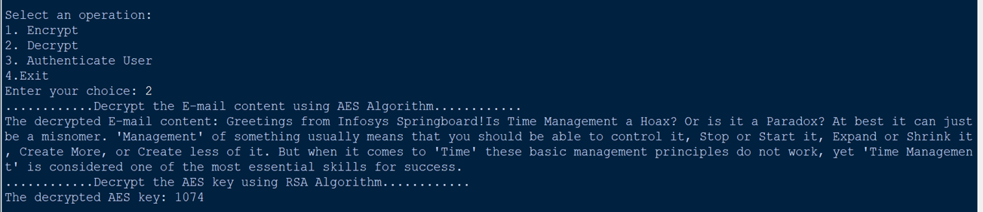
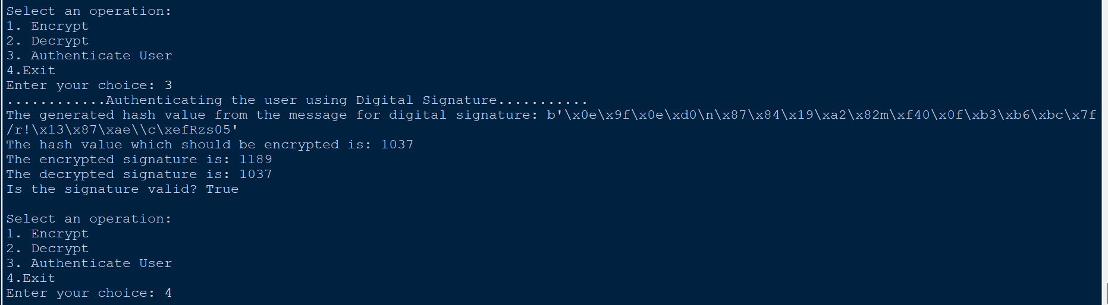
Experiment Screenshots

Slide 18
Experiment Results
Message length | RSA Encryption time | RSA Decryption time | Hybrid Encryption time | Hybrid Decryption time
128 bits | 0.04 sec | 0.60 sec | 0.025 sec | 0.51 sec
256 bits | 0.11 sec | 0.86 sec | 0.07 sec | 0.55 sec
512 bits | 0.21 sec | 1.31 sec | 0.15 sec | 0.65 sec
1024 bits | 0.31 sec | 1.76 sec | 0.19 sec | 0.69 sec
2048 bits | 0.49 sec | 2.68 sec | 0.32 sec | 0.81 sec
5096 bits | 0.59 sec | 3.2 sec | 0.38 sec | 0.88 sec

Slide 19
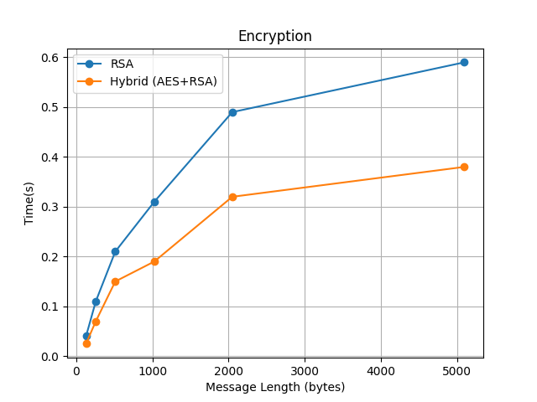
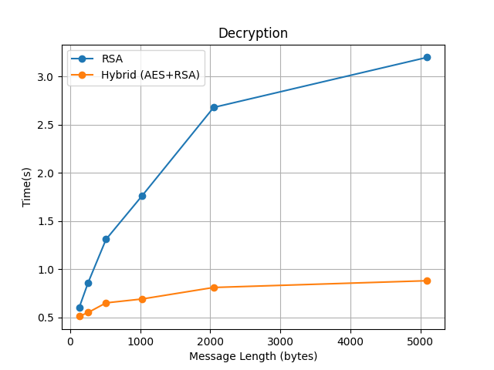
Experiment Results

Slide 20
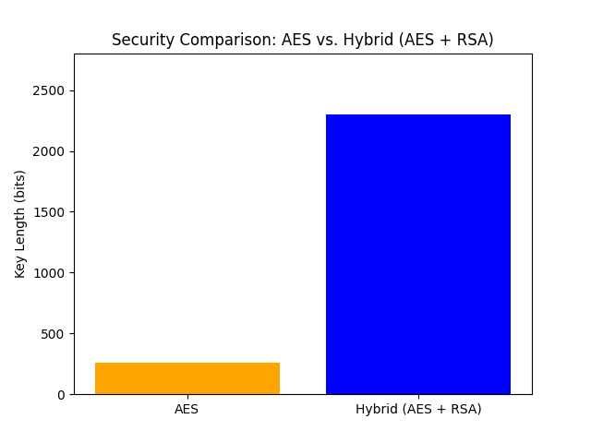
Experiment Results
From above experiment we can say that RSA computational time is more when compared to Hybrid algorithm. But the problem with using AES algorithm is prone to some attacks which are solved by using Hybrid algorithm.
Type of Attack | AES algorithm | Hybrid algorithm
Brute-force attack | As we are using 256 bits key length, there 2²⁵⁶ possible ways to identify which a hacker can find out. | We are using RSA to encrypt the AES key. If we use larger keys it is very difficult to decode the key, which ensures double security.
Man-in-the-middle attack | If an intruder eavesdrop on the sender and identify the key, it is very easy for him to decrypt the message | Even if the intruder eavesdrop there is no use because he cannot decrypt until he knows the receiver's private key

Slide 21
Findings
Confidentiality: AES encryption ensures that only the intended recipient can decrypt and read the email, maintaining confidentiality.
Authentication: RSA-based digital signatures can authenticate the sender of the email, confirming that the message indeed comes from the claimed source.
Secure Key Exchange: The RSA algorithm can be used for secure key exchange, ensuring that both the sender and recipient share a secret key without interception.
Mitigation of Man-in-the-Middle Attacks: By combining RSA with digital signatures, you can mitigate man-in-the-middle attacks, where an attacker intercepts and modifies email content.
Overall, the project ensures that email communication is secure, private, and trustworthy.

Slide 22
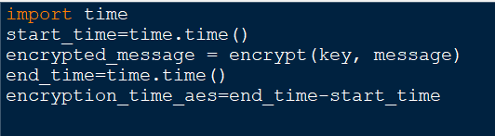
Justification
The parameters that are improved in our project
Security, Key Exchange mechanism, Speed and Performance
Mathematical Formula
Encryption time of Hybrid= Encryption time of AES+ Encryption time of RSA
Decryption time of Hybrid= Decryption time of AES+ Decryption time of RSA
Key length of Hybrid= Key length of AES+ Key length of RSA
In what way parameters are improved
Security: It provides confidentiality to the message using AES and authentication using RSA
Key Management: Keys are managed and the keys are transferred securely using RSA.
Speed and Performance: RSA takes longer time to encrypt large amount of data that’s why we are using RSA only for key management, which ensures the less encryption/decryption time.

